Slide 1
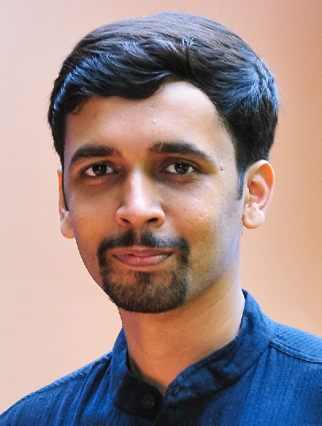

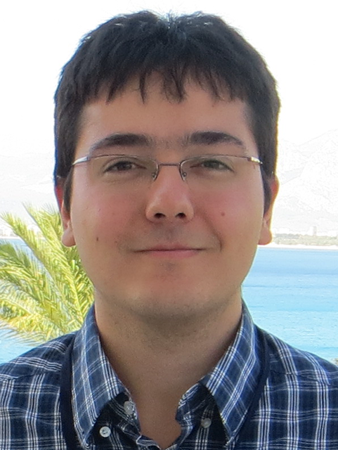

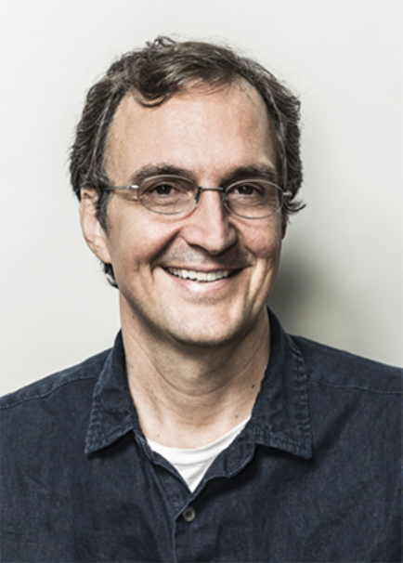


Color Temperature Tuning:
Allowing Accurate Post-Capture White-Balance Editing
Mahmoud | Abhijith | Abdelrahman | Hakki C. | Abdullah | Michael S.
Afifi | Punnappurath | Abdelhamed | Karaimer | Abuolaim | Brown
,2
1
,3
,4
1
1
,2
1
1
1
1
York University – Toronto, Canada
Samsung AI Centre - Canada
Apple Inc, USA
EPFL, Switzerland
2
3
4
Oct 21-25, 2019

Slide 2
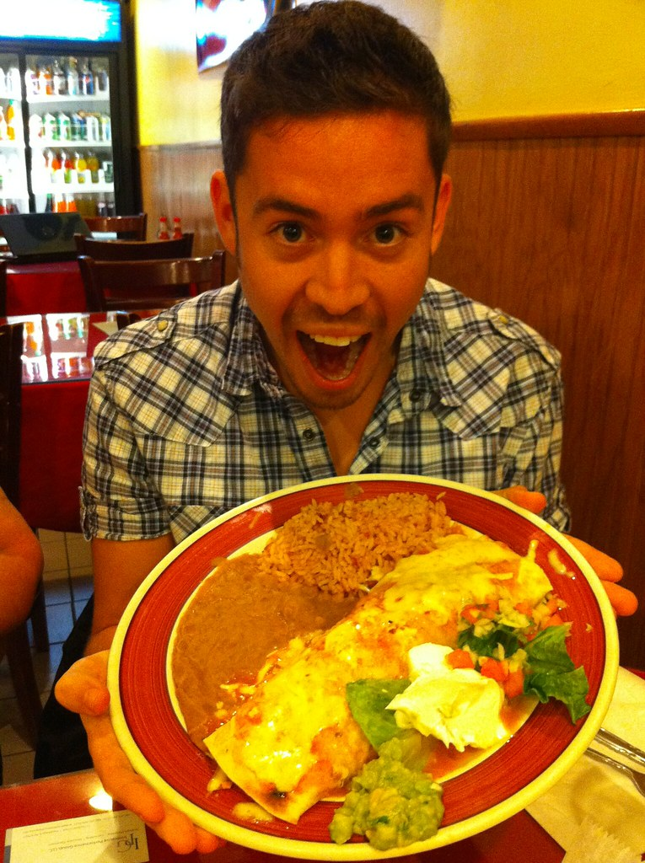
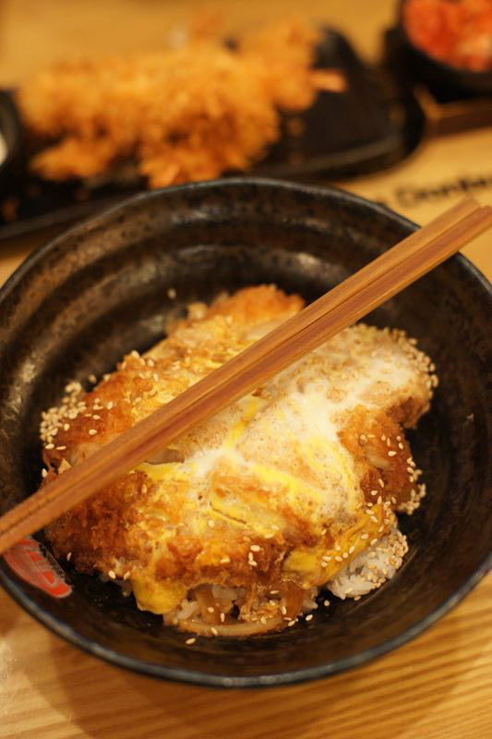
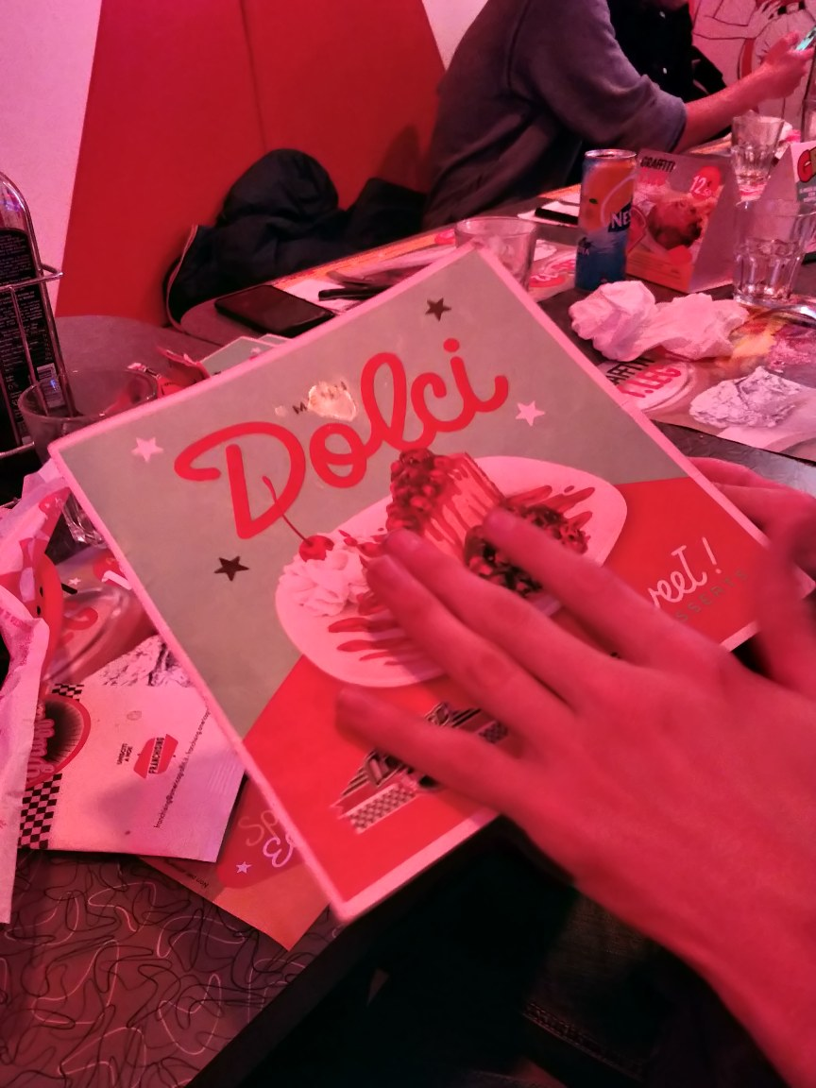
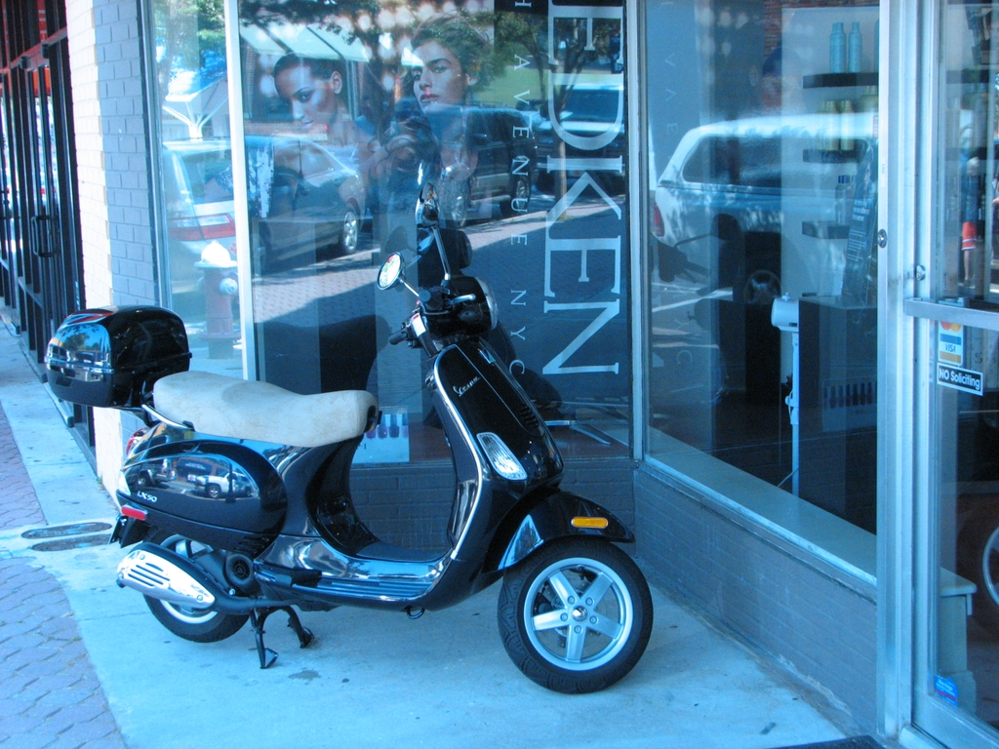
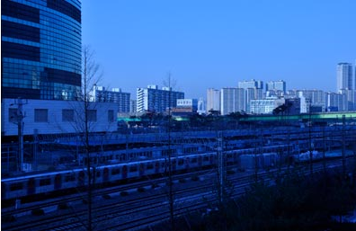
We all recognize this problem

Slide 3
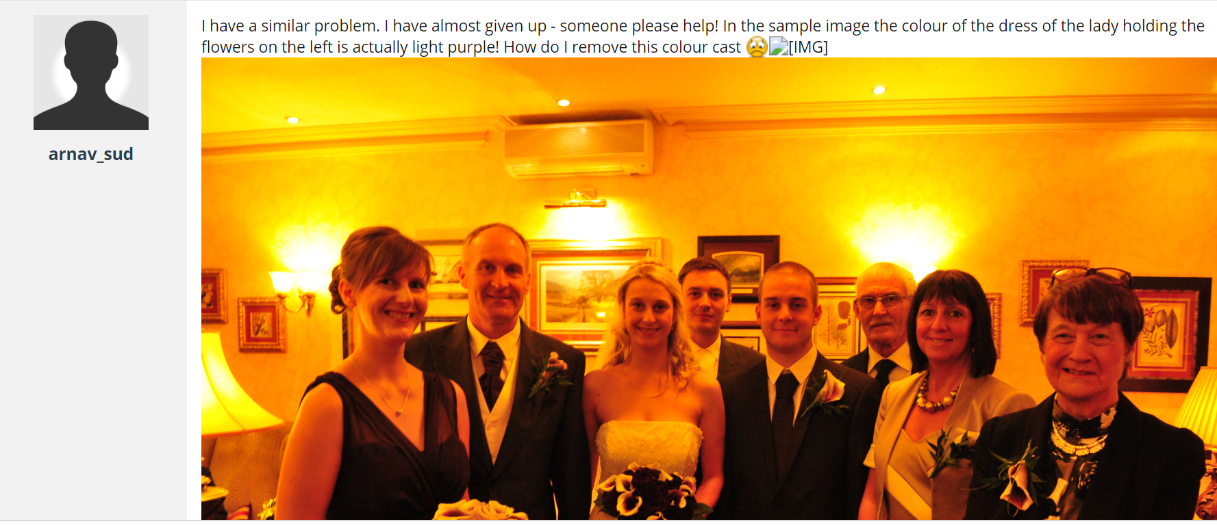
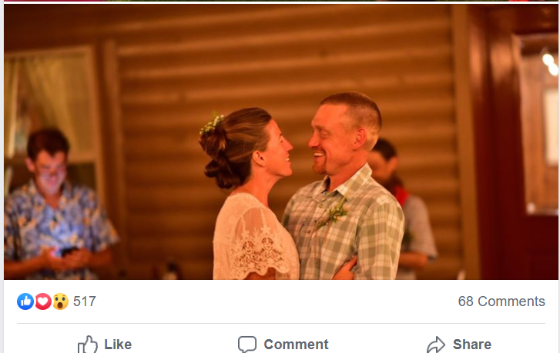
Here is a plea for help
I have a similar problem. I have almost given up – someone please help! ..… How do I remove this colour cast :-(

Slide 4
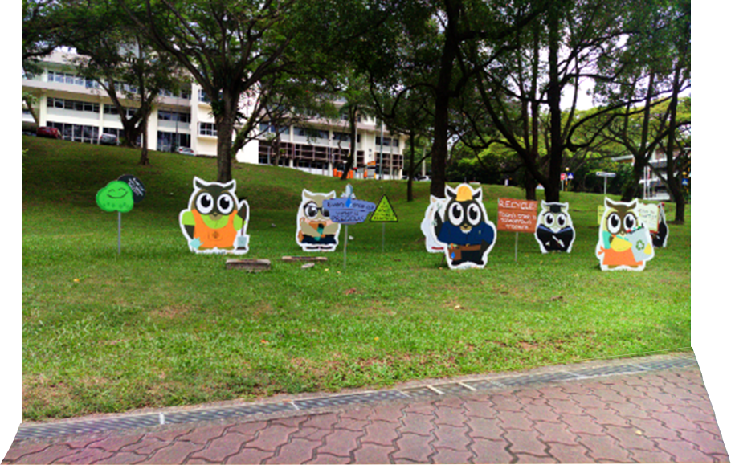

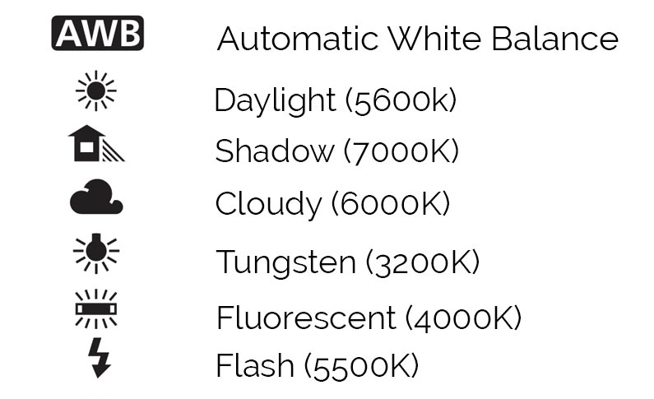
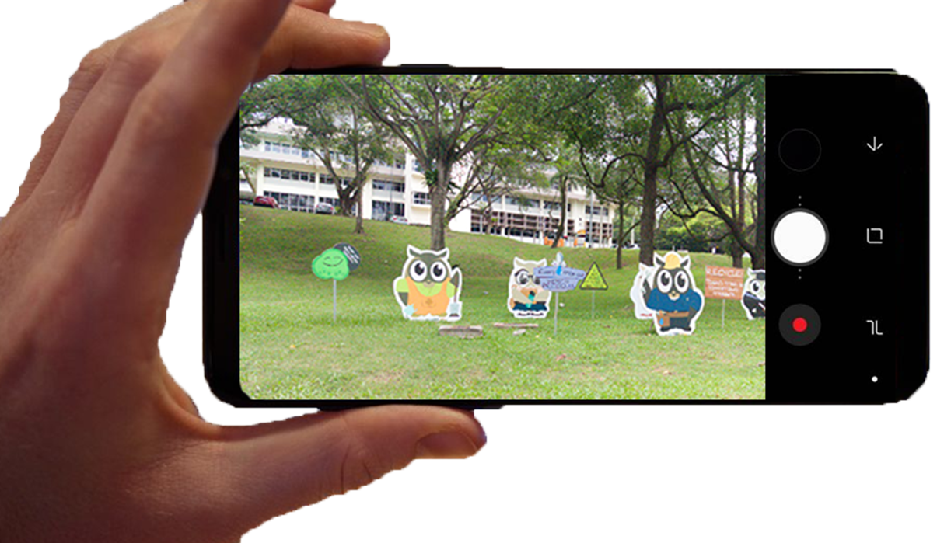
What is the problem?
Scene illumination
When you take a photo,
you have to take the scene
illumination into account.
White-balance
illumination setting
White-balance setting

Slide 5
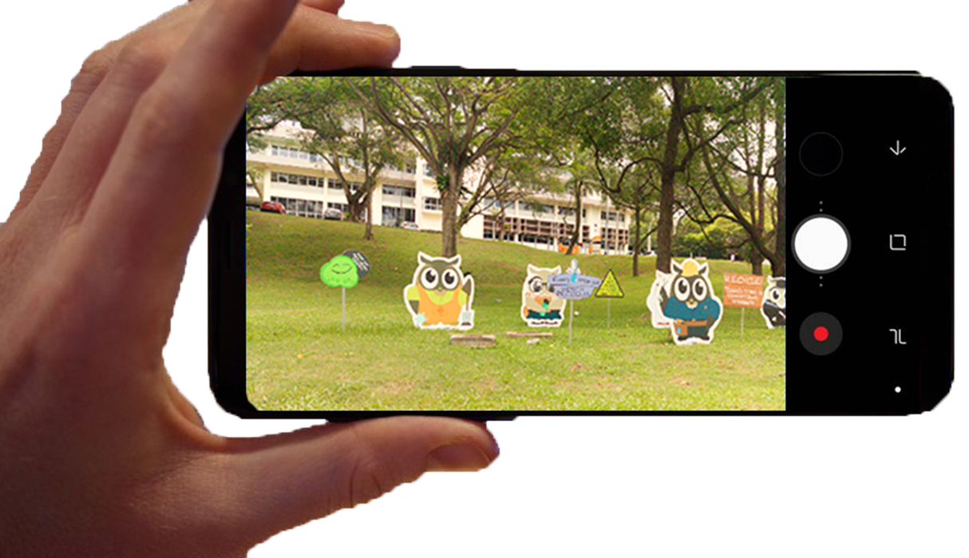
What is the problem?
Scene illumination
When you take a photo,
you have to take the scene
illumination into account.
Using the wrong
white balance
introduces a noticeable
color cast.
White-balance setting

Slide 6
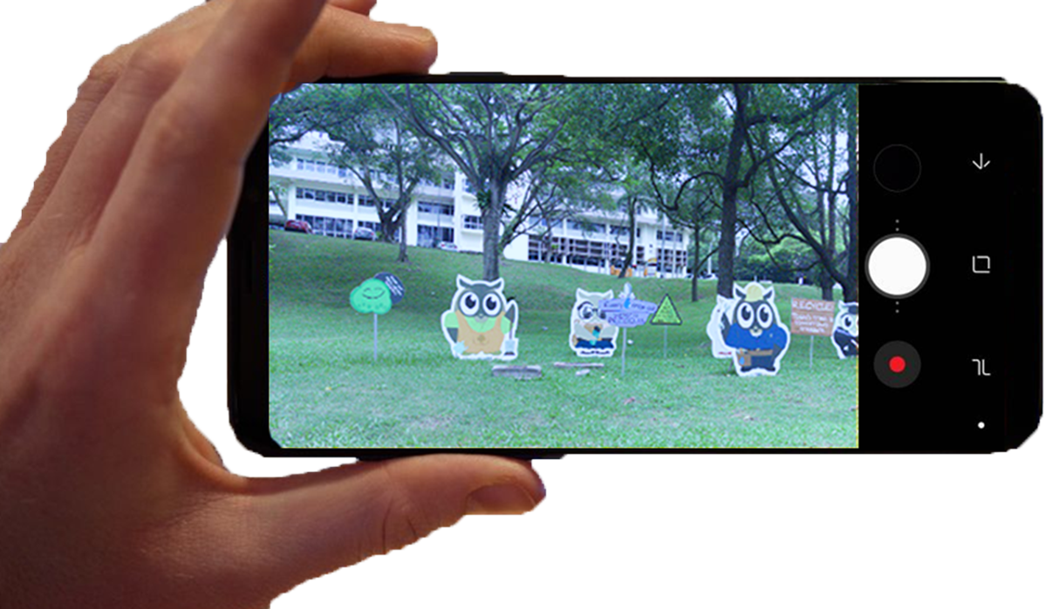
What is the problem?
Scene illumination
When you take a photo,
you have to take the scene
illumination into account.
Using the wrong
white balance
introduces a noticeable
color cast.
White-balance setting

Slide 7
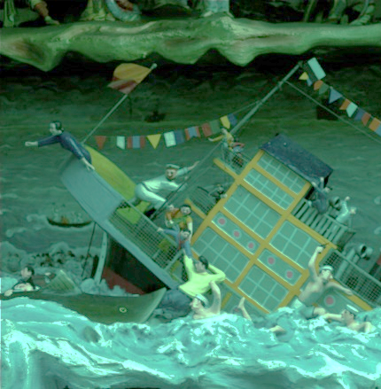
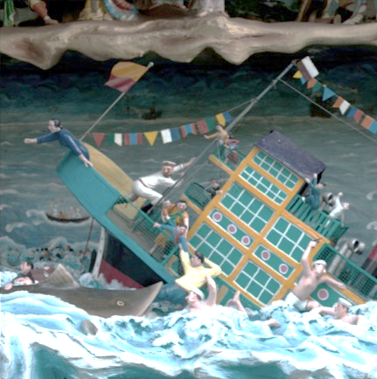
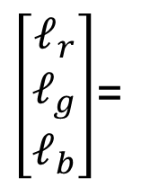
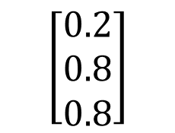
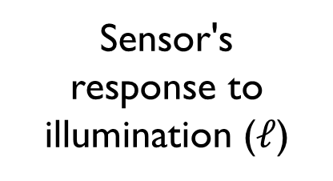
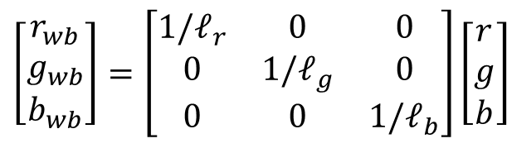
How does white balance (WB) work?
Sensor's
response to illumination ($ℓ$)
$\left[\begin{matrix}ℓ_{r} \\ ℓ_{g} \\ ℓ_{b}\end{matrix}\right]$=
$$\left[\begin{matrix}0.2 \\ 0.8 \\ 0.8\end{matrix}\right]$$
raw-RGB sensor image
(pre-white-balance correction)
“White-balanced”
raw-RGB image
$$\left[\begin{matrix}r_{wb} \\ g_{wb} \\ b_{wb}\end{matrix}\right]=\left[\begin{matrix}{1/ℓ}_{r} & 0 & 0 \\ 0 & {1/ℓ}_{g} & 0 \\ 0 & 0 & {1/ℓ}_{b}\end{matrix}\right]\left[\begin{matrix}r \\ g \\ b\end{matrix}\right]$$
White-balance
diagonal matrix

Slide 8
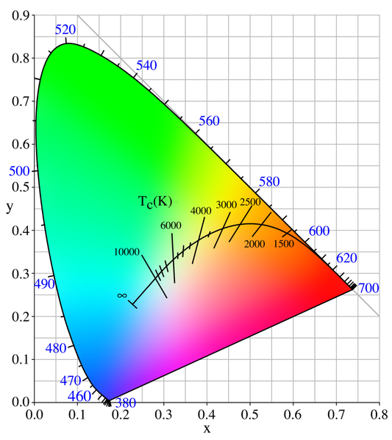
WB as a color temperature
In photography, it is common to
refer to the "temperature" of the
illumination.
Correlated Color Temperature (CCT)
plotted in CIE xy

Slide 9
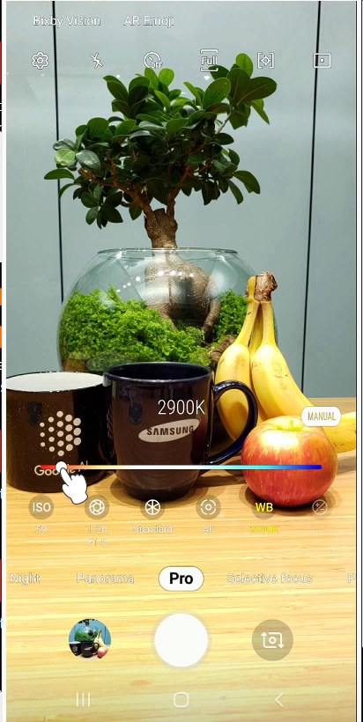
WB as a color temperature

Slide 10
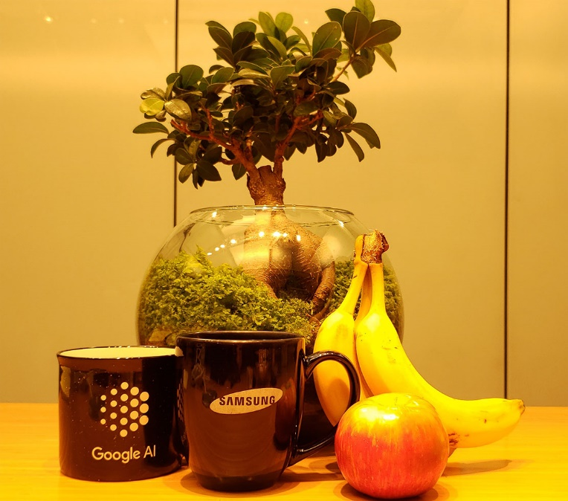
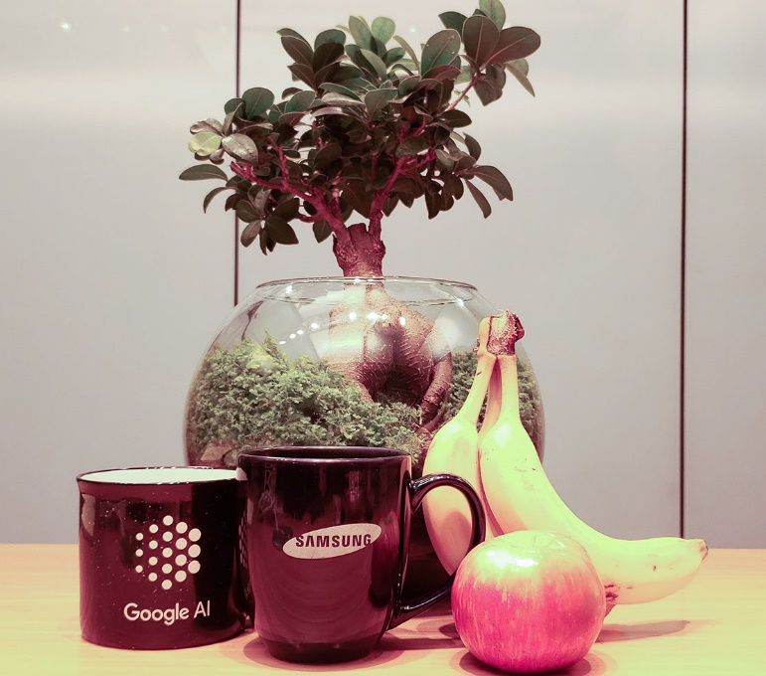
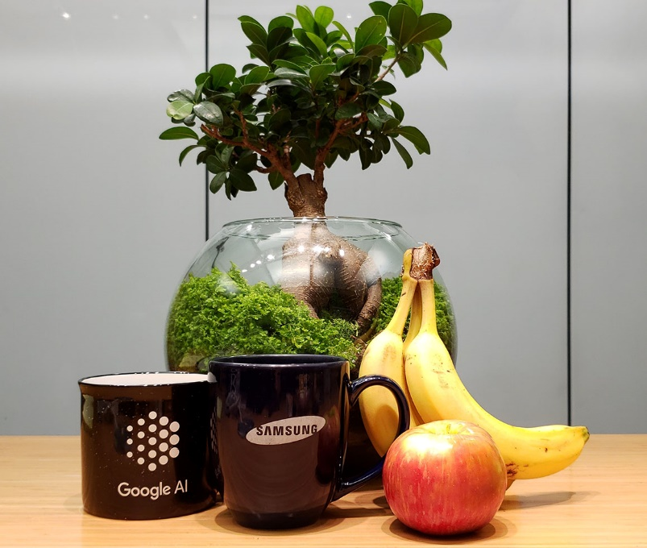
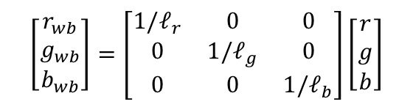
Correcting an incorrectly WB image
input: wrong WB
Post-capture correction using a
WB matrix
Captured with the right WB
$$\left[\begin{matrix}r_{wb} \\ g_{wb} \\ b_{wb}\end{matrix}\right]=\left[\begin{matrix}{1/ℓ}_{r} & 0 & 0 \\ 0 & {1/ℓ}_{g} & 0 \\ 0 & 0 & {1/ℓ}_{b}\end{matrix}\right]\left[\begin{matrix}r \\ g \\ b\end{matrix}\right]$$

Slide 11
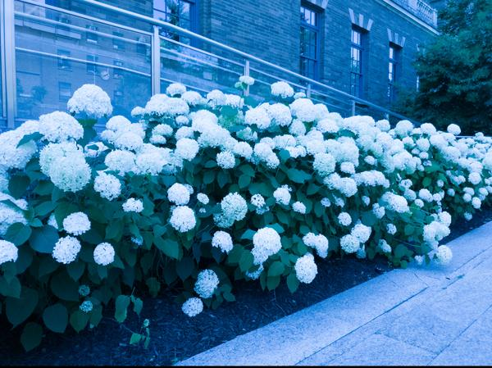
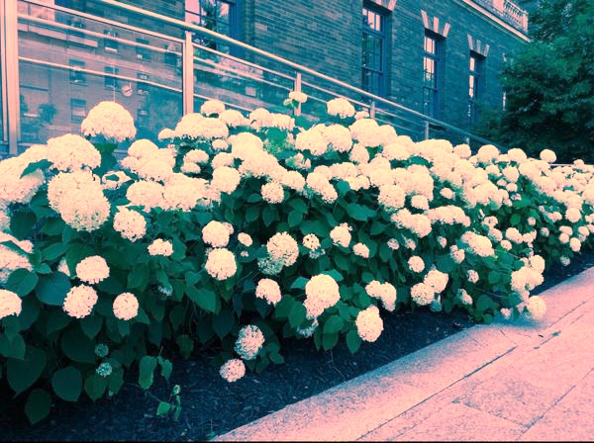
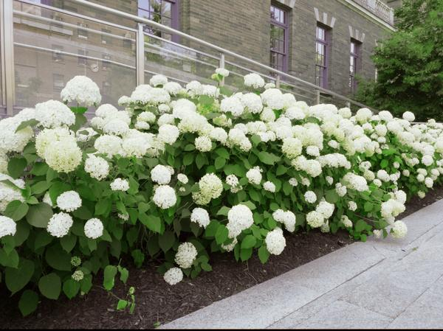
Correcting an incorrectly WB image
input: wrong WB
Post-capture correction using a
WB matrix
Captured with the right WB
$$\left[\begin{matrix}r_{wb} \\ g_{wb} \\ b_{wb}\end{matrix}\right]=\left[\begin{matrix}{1/ℓ}_{r} & 0 & 0 \\ 0 & {1/ℓ}_{g} & 0 \\ 0 & 0 & {1/ℓ}_{b}\end{matrix}\right]\left[\begin{matrix}r \\ g \\ b\end{matrix}\right]$$

Slide 12
Why is this hard to correct?
Notes:
According to Wikipedia and some photography sites, point-and-shoot cameras do not include smartphones. The categorization is DSLRs, bridge, and point-and-shoot cameras. Smartphones do not figure on this list.

Slide 13
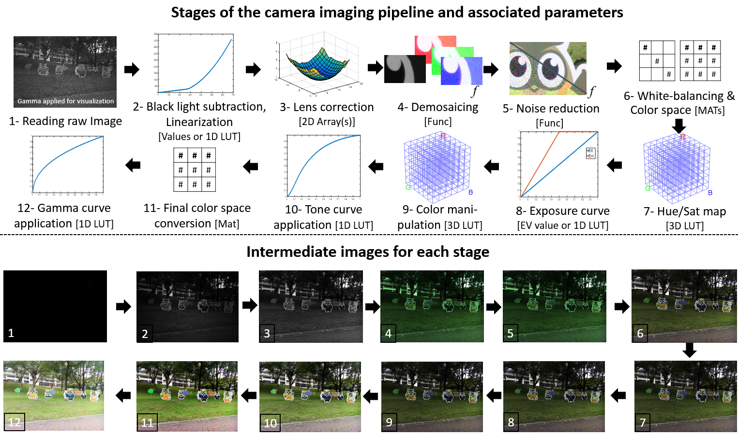
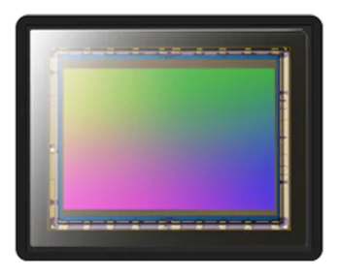
In-camera processing pipeline
Sensor
input:
raw-RGB
sRGB
(standard RGB)
output:
Figure from [Karaimer and Brown, ECCV, 2016]

Slide 14

Mistakes when capturing photos
Mistakes made early
in the camera pipeline
are propagated.
raw-RGB
sRGB

Slide 15


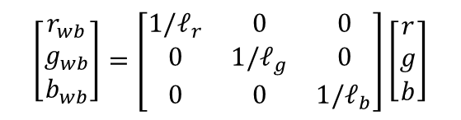
Mistakes when capturing photos
Mistakes made early
in the camera pipeline
are propagated.
Surprisingly, many
resources erroneously suggest this will work!
$$\left[\begin{matrix}r_{wb} \\ g_{wb} \\ b_{wb}\end{matrix}\right]=\left[\begin{matrix}{1/ℓ}_{r} & 0 & 0 \\ 0 & {1/ℓ}_{g} & 0 \\ 0 & 0 & {1/ℓ}_{b}\end{matrix}\right]\left[\begin{matrix}r \\ g \\ b\end{matrix}\right]$$

Slide 16
Related work
Radiometric calibration
Debevec SIG'97, Anderson CIC'98, Grossberg TPAMI'03, Chakrabarti BMVC'09, …
  Model the nonlinear processing in the camera pipeline
Raw reconstruction
Lin ICCV'11, Kim TPAMI'12, Nyugen CVPR'18, Gong CIC'18, Punnappurath TPAMI'19
  Map sRGB image back to the starting point raw-RGB

Slide 17
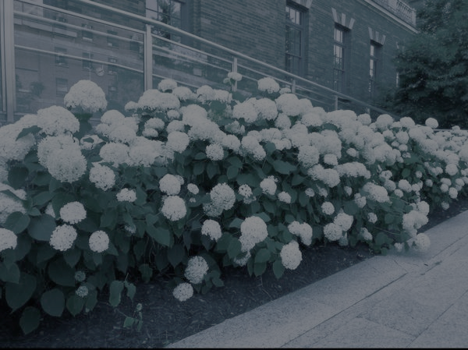
Raw reconstruction: pros and cons
Reverse the in-camera processing to get back raw-RGB.
Often requires calibration procedure.
May need to know the settings
used at capture time to undo the
processing.
reconstructed raw-RGB
output: wrong WB (sRGB)
Re-apply camera processing pipeline in software with "correct" settings.
Requires us to know how to apply forward in-camera processing.
Camera manufacturer may not want to reveal this information.
Reprocessed sRGB image
from reconstructed raw-RGB

Slide 18
Our proposed framework
Allow accurate post-capture white-balance correction
Avoid the need for calibration
Avoid the need to know the in-camera rendering process
Small memory and computational overhead

Slide 19
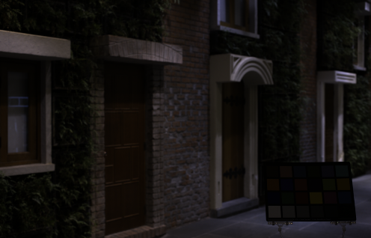
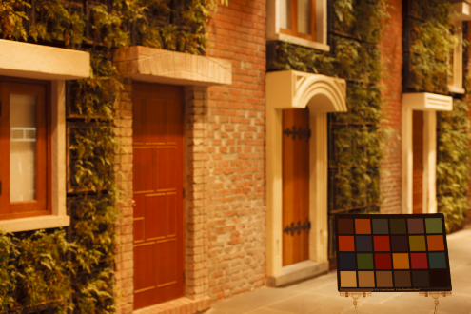











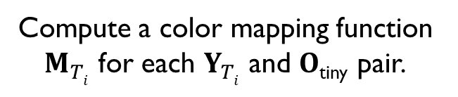




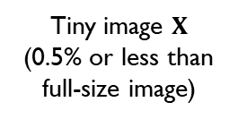











Proposed framework
Standard imaging procedure
Full-size image’s passed to
pipeline with
fixed WB setting.
Camera pipeline
White balance
Demosaicing
$O$_{tiny}
$${T=2500K}_{ }$$
Sub-sample
Noise reduction
raw-RGB $I$
sRGB Image $O$
$$I$$
Color space mapping
Sub-sample
$${T=2500K}_{ }$$
Tone mapping/gamma
$${T=4000K}_{ }$$
..
Tiny image $X$
(0.5% or less than full-size image)
$${T=5500K}_{ }$$
$${T=7000K}_{ }$$
Color rendering (Yuv processing)
$$Y_{2500K }$$
$$Y_{4000K}$$
$$Y_{8500K}$$
$${T=8000K}_{ }$$
Tiny sRGB images $Yi$
Tiny images X rendered through
pipeline with 5 fixed color temperatures
Additional processing
sRGB/Yuv output
$$2$$
$${argmin}_{M_{Ti}}$$
$$M_{Ti}ɸ( )$$
$−$
$O$_{tiny}
$$Y_{Ti}$$
$$F$$
Compute a color mapping function $M_{Ti}$ for each $Y_{Ti}$ and $O$_{tiny} pair.
Notes:
This figure seems to be old, demosaic is still part of the pipeline.

Slide 20

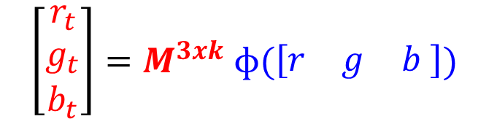
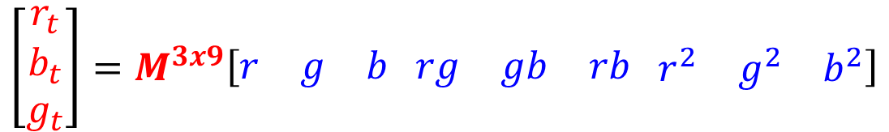
Color mapping function M
$$\left[\begin{matrix}r_{t} \\ g_{t} \\ b_{t}\end{matrix}\right]=M^{3xk} ɸ(\left[\begin{matrix}r & g & b\end{matrix} \right])$$
original image
(tiny version)
target image
Y_{2500K}
O_{tiny}
where k is dim of kernel function $ɸ$ .
$$\left[\begin{matrix}r_{t} \\ b_{t} \\ g_{t}\end{matrix}\right]=M^{3x9}\left[\begin{matrix}r & g & b\end{matrix} \begin{matrix}rg & gb & rb\end{matrix} \begin{matrix}r^{2} & g^{2} & b^{2}\end{matrix}\right]$$
example with k=9.
Finlayson et al, TIP 2015

Slide 21
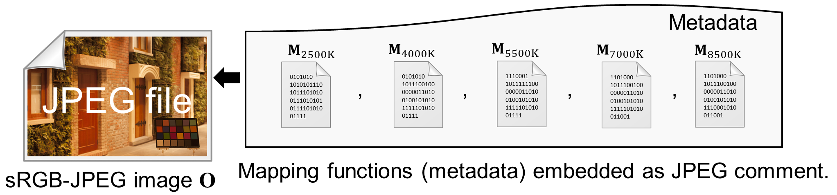
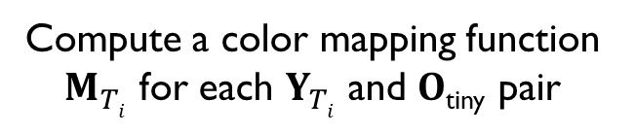

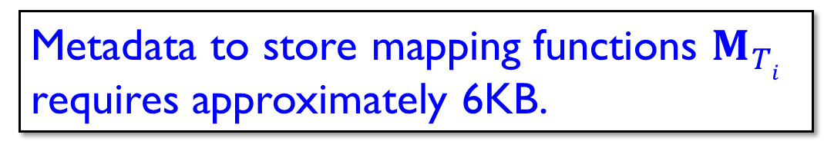
Proposed framework
Full-size mage’s passed to
pipeline with
fixed WB setting.
Camera pipeline
White balance
Demosaicing
$O$_{tiny}
$${T=2500K}_{ }$$
Sub-sample
Noise reduction
raw-RGB $I$
sRGB image $O$
$$I$$
Color space mapping
Sub-sample
$${T=2500K}_{ }$$
Tone mapping/gamma
$${T=4000K}_{ }$$
..
Tiny image $X$
(0.5% or less than full-size image)
$${T=5500K}_{ }$$
$${T=7000K}_{ }$$
Coluor rendering (Yuv processing)
$$Y_{2500K }$$
$$Y_{4000K}$$
$$Y_{8500K}$$
$${T=8000K}_{ }$$
Tiny sRGB images $Yi$
Tiny images X rendered through
pipeline with 5 fixed color temperatures
Additional processing
sRGB/Yuv output
$$2$$
$${argmin}_{M_{Ti}}$$
$$M_{Ti}ɸ( )$$
$−$
$O$_{tiny}
$$Y_{Ti}$$
$$F$$
Metadata to store mapping functions $M_{Ti}$ requires approximately 6KB.
Compute a color mapping function $M_{Ti}$ for each $Y_{Ti}$ and $O$_{tiny} pair
Notes:
This figure seems to be old, demosaic is still part of the pipeline.

Slide 22
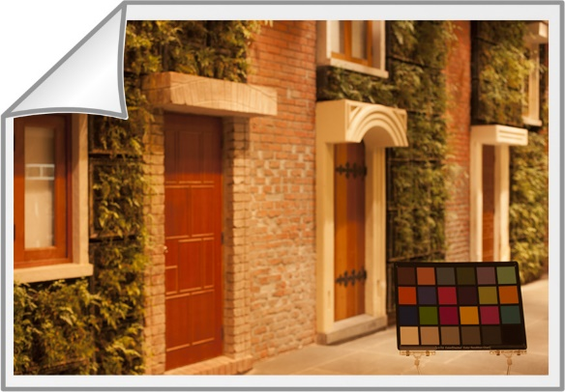
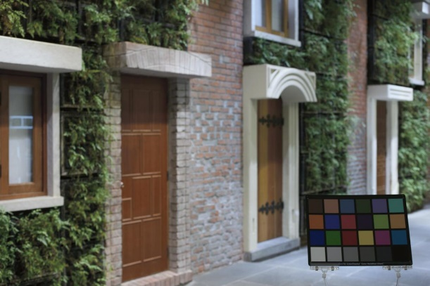
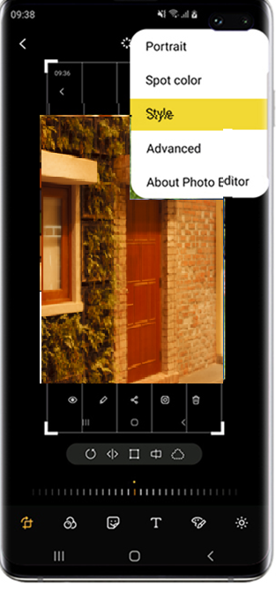



Applying color manipulation post-capture
Extract metadata to correct image
Extract metadata
JPEG file
$$M_{2500K}$$
0101010
101010111010111010100111010101011110101001111
sRGB-JPEG image O
$$M_{2500K}ɸ(\text{O})$$
Metadata extracted and used to modify image O
Example: Target temperature (t) is 2500K
Notes:
2500 is part of our set of pre-selected WBs in the paper

Slide 23
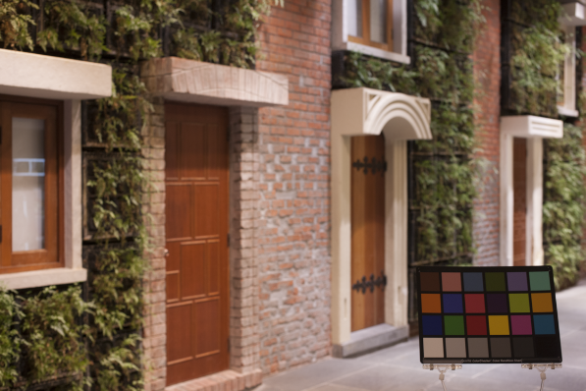
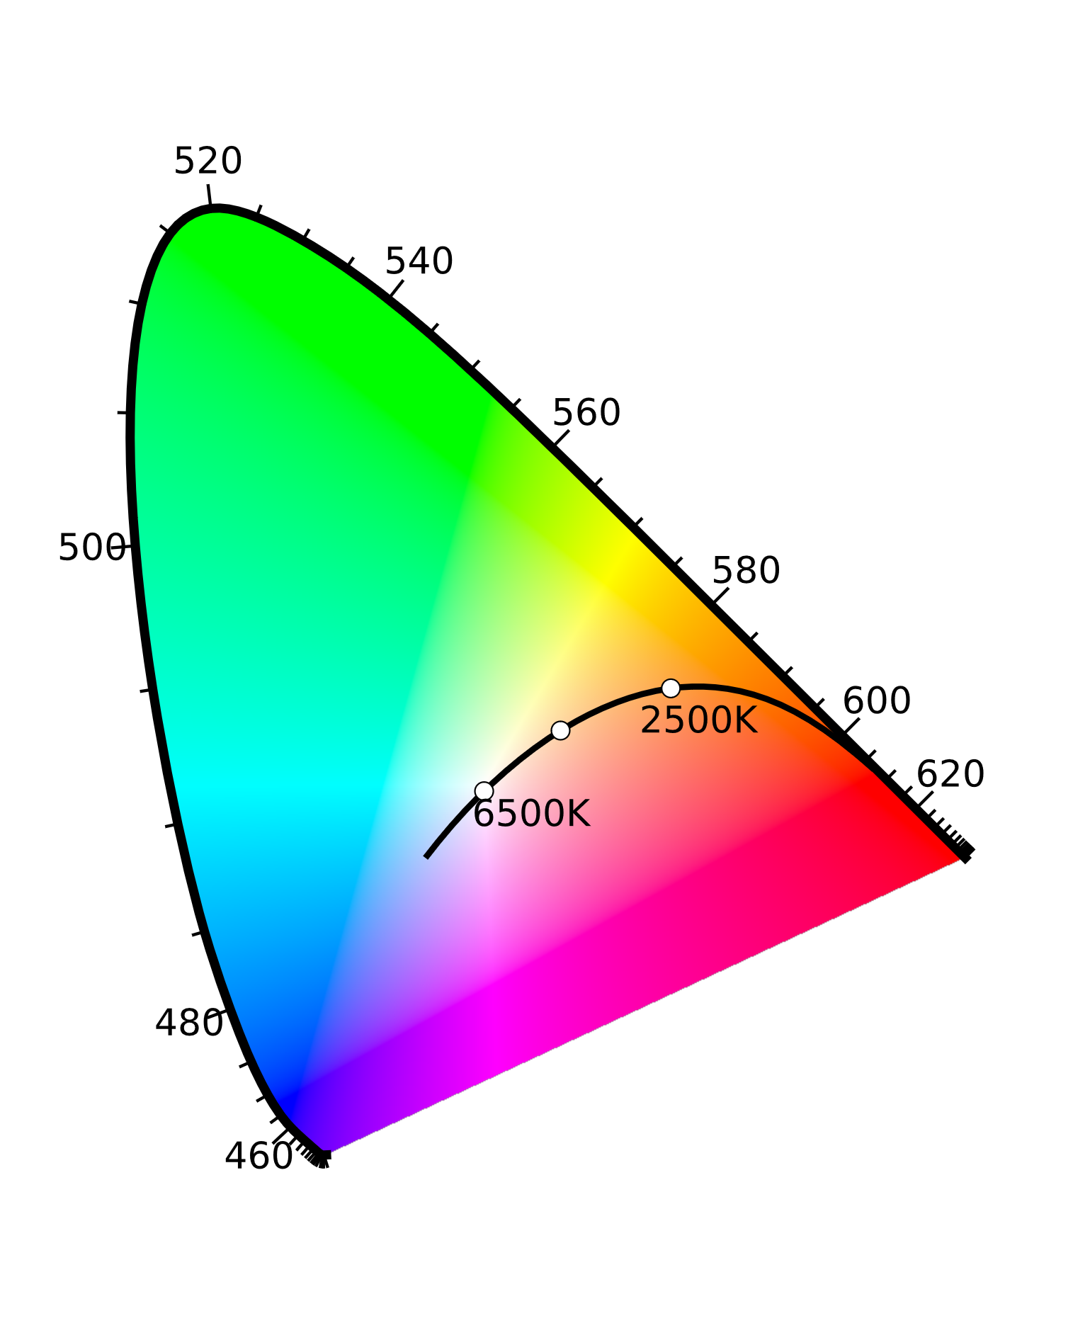








Applying color manipulation post-capture
Target white-balance is not one of our presets
Correlated Color Temperatures in CIE Yxy
Extract metadata
JPEG file
$${3500}^{∘}K$$
$${ 2500}^{∘}K$$
$${4000}^{∘}K$$
1-g
g
$$M_{2500K}$$
$$M_{4000K}$$
0101010
101010111010111010100111010101011110101001111
0101010
10111001000000011010010010101011111010100111
sRGB-JPEG image O
$$M_{4000K}ɸ(\text{O})$$
${gM}_{2500K}ɸ\left(\text{O}\right)+(1−g$)
Metadata extracted and used to modify image O
Example #2: Target temperature (t) is 3500K

Slide 24


Color temperature tuning
Original image captured + 6KB of metadata embedded as a JPEG comment

Slide 25

Color temperature tuning
Original image captured + 6KB of metadata embedded as a JPEG comment

Slide 26












Results
$∆E$ = 8.95
$∆E$ = 4.25
t = 6500K
$∆E$ = 9.47
$∆E$ = 4.15
t = 2850K
Input sRGB-rendered images
Diagonal results
Our results
In-camera rendered images with target temperatures (t)

Slide 27












Results
$∆E$ = 6.53
$∆E$ = 3.29
t = 5500K
$∆E$ = 5.68
$∆E$ = 3.66
t = 2850K
Input sRGB-rendered images
Diagonal results
Our results
In-camera rendered images with target temperatures (t)

Slide 28
Additional applications
Notes:
According to Wikipedia and some photography sites, point-and-shoot cameras do not include smartphones. The categorization is DSLRs, bridge, and point-and-shoot cameras. Smartphones do not figure on this list.

Slide 29




Dual-illumination scene
Input image rendered with WB setting for the 1st illuminant
Modified image using our method with WB setting for the 2nd illuminant
Blending mask (by lazy snapping method [Li et al., ToG, 2004])
Final corrected image

Slide 30






Raw image reconstruction
Camera JPEG rendered sRGB image
Camera demosaiced raw image
Our reconstructed
demosaiced raw image
$$\left[\begin{matrix}r_{t} \\ g_{t} \\ b_{t}\end{matrix}\right]=M^{3xk} ɸ(\left[\begin{matrix}r & g & b\end{matrix} \right])$$
target image
raw-RGB
(tiny)
O_{tiny}

Slide 31



Tuning different camera settings
Standard Style
Portrait Style
Landscape Style

Slide 32








Tuning different camera settings
Full-size mage’s passed to
pipeline with
fixed setting.
Camera pipeline
White balance
Demosaicing
$O$_{tiny}
Sub-sample
Noise reduction
raw-RGB $I$
sRGB image $O$
$$I$$
Color space mapping
Sub-sample
$${T=Style1}_{ }$$
Tone mapping/gamma
Tiny image $X$
(0.5% or less than full-size image)
$${T=Style2}_{ }$$
..
$${T=Style3}_{ }$$
Coluor rendering (Yuv processing)
$$Y_{Style1 }$$
$$Y_{Style2}$$
$$Y_{Style3}$$
Tiny sRGB images $Yi$
Tiny images X rendered through
pipeline with N pre-defined settings.
Additional processing
sRGB/Yuv output
$$2$$
$${argmin}_{M_{Ti}}$$
$$M_{Ti}ɸ( )$$
$−$
$O$_{tiny}
$$Y_{Ti}$$
$$F$$
Compute a color mapping function $M_{Ti}$ for each $Y_{Ti}$ and $O$_{tiny} pair
Notes:
This figure seems to be old, demosaic is still part of the pipeline.

Slide 33







Tuning different settings
Camera style (CS) modification
CS: Camera default
CS: Camera Landscape
CS: Camera Neutral
CS: Camera Faithful
Camera JPEG sRGB image with different camera styles. Input is the original raw image.
CS: Camera default
CS: Camera Landscape
CS: Camera Neutral
CS: Camera Faithful
Our camera style modification results. Input image is a JPEG image with camera default camera style (in yellow border)

Slide 34
Summary
Presented an imaging framework for robust image manipulation
  Allows for accurate post-capture WB correction
  Self-contained correction with small overhead
Additional analysis in the paper on successive manipulation
Framework can be extended beyond white-balance
We are truly honored to receive the best paper award!

Slide 35


Thank you
Questions?
Notes:
Change this figure after fixing this same figure in previous slides.

